Slide 1











Visualization with the ArcGIS API for JavaScript
Kristian Ekenes
2020 ESRI FEDERAL GIS CONFERENCE | WASHINGTON, D.C.

Slide 2




Discover how to visualize geodata in a meaningful way using the ArcGIS API for JavaScript
Notes:
Motivation – why are they here

Slide 3
API Overview
Renderers, symbols, etc.

Slide 4
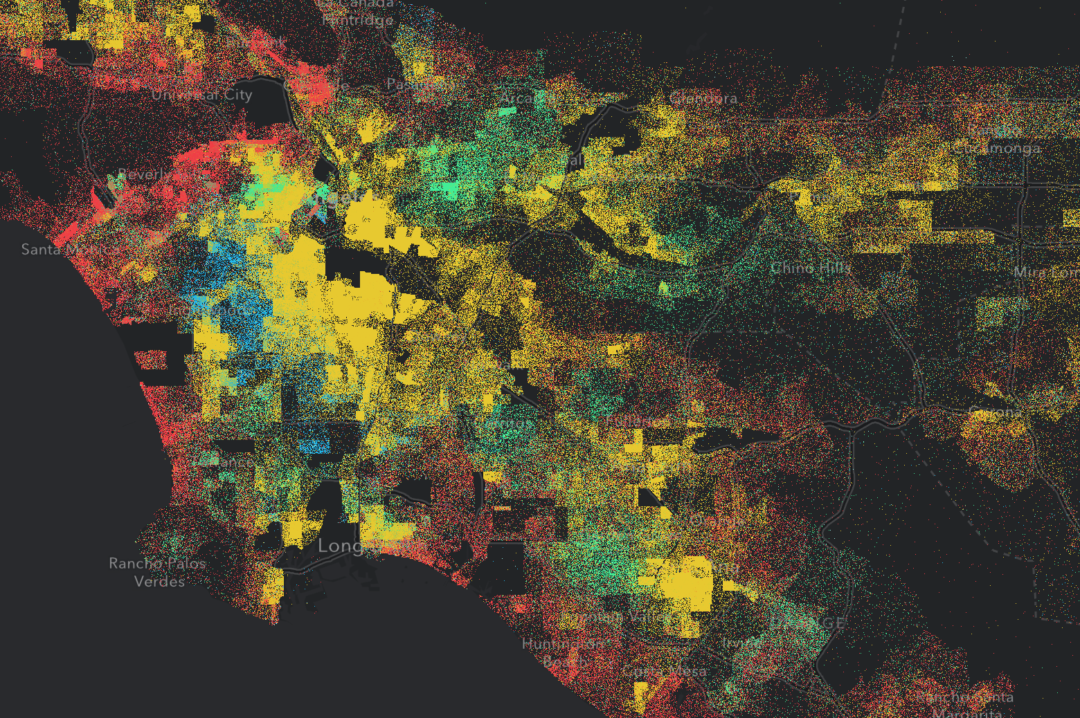
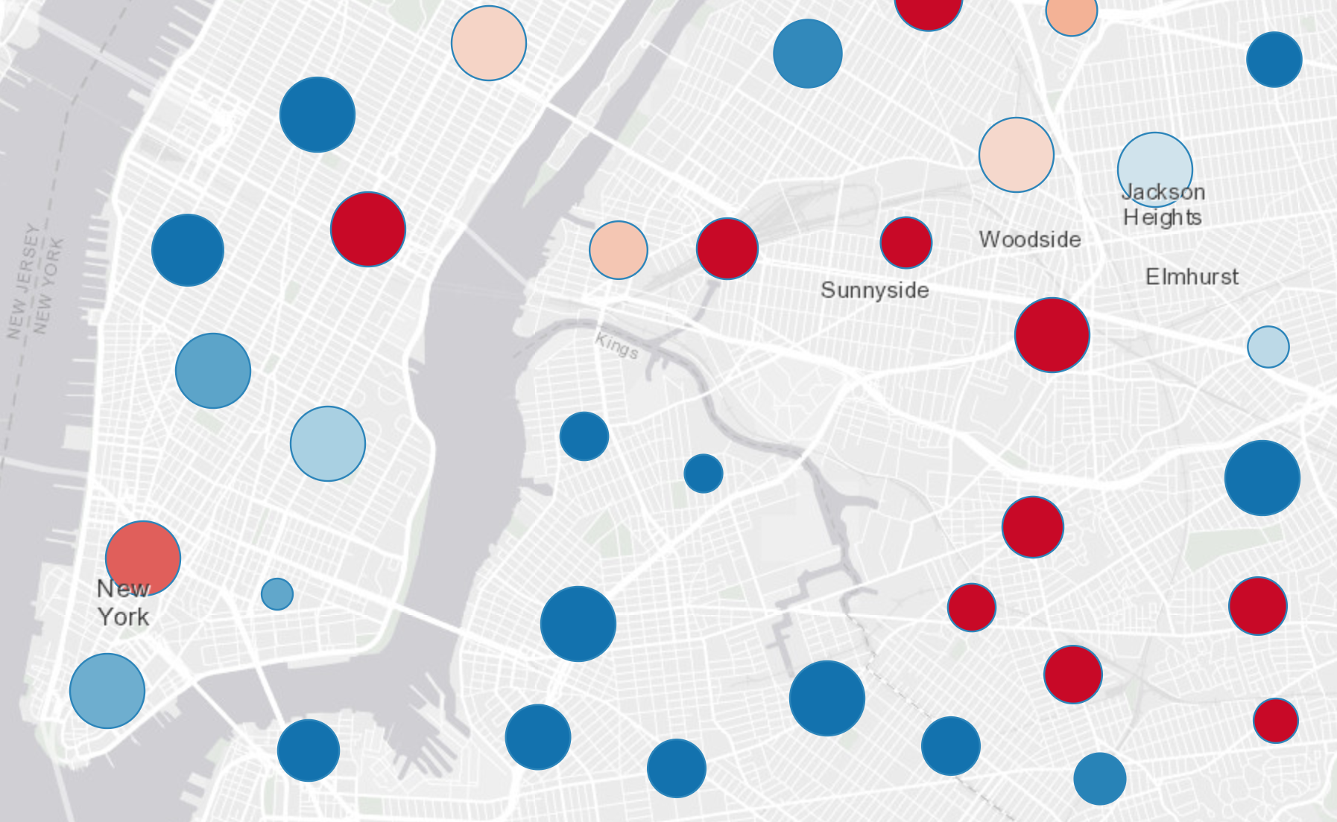
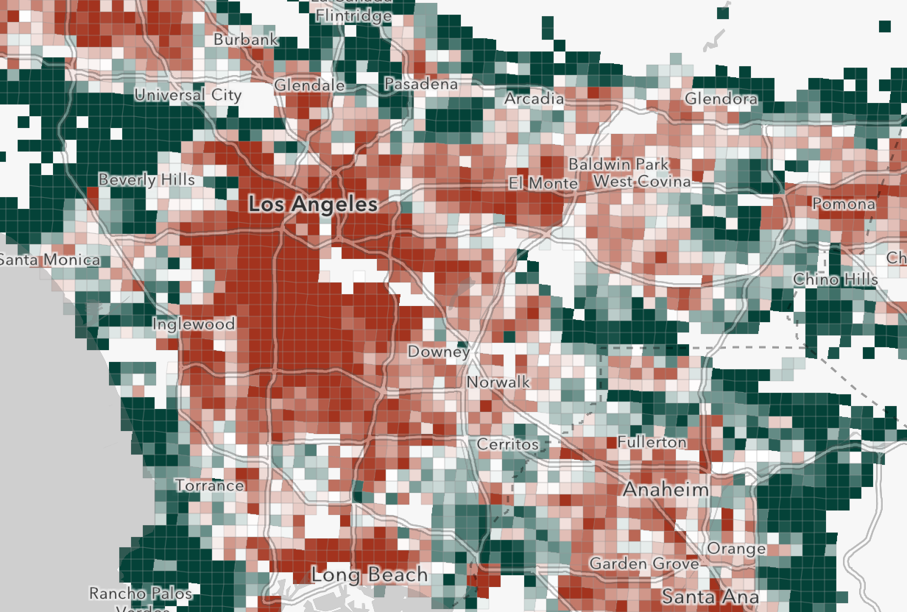
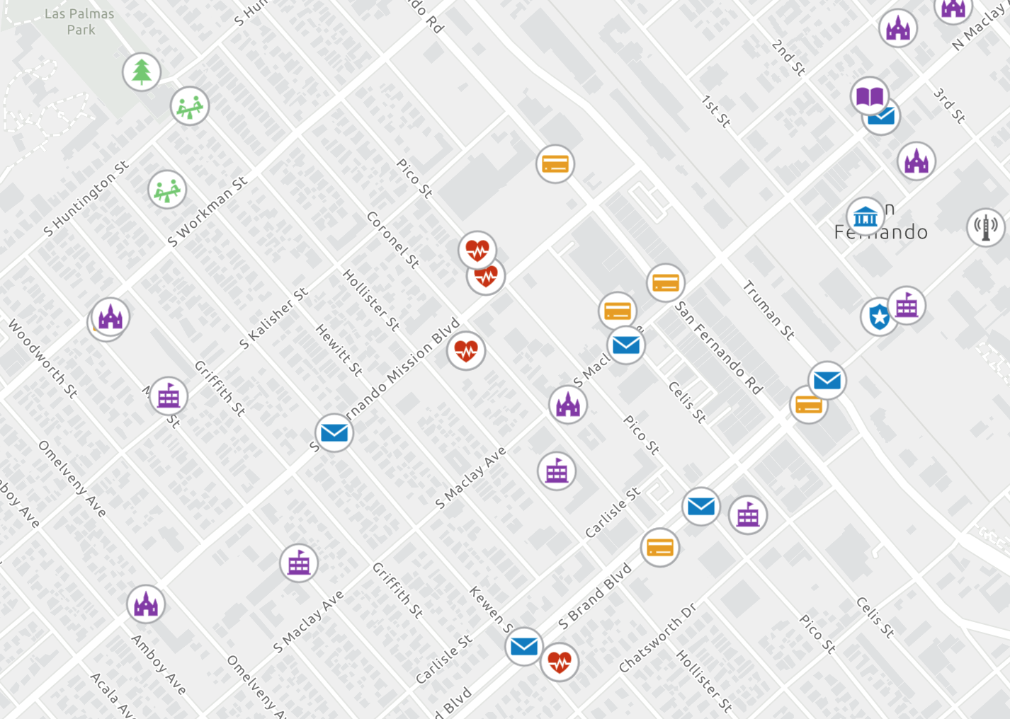
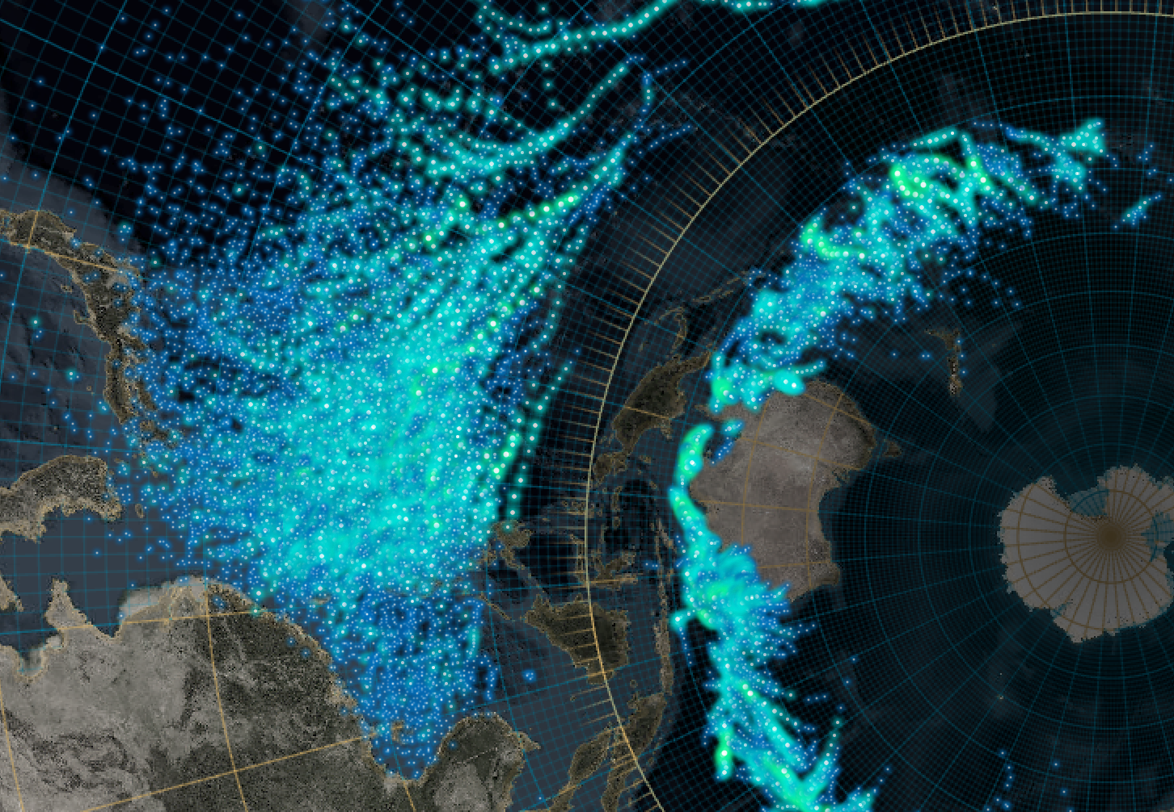






What can we visualize?
Where?
What?
How much?
When?
Multivariate

Slide 5
Symbols

Slide 6
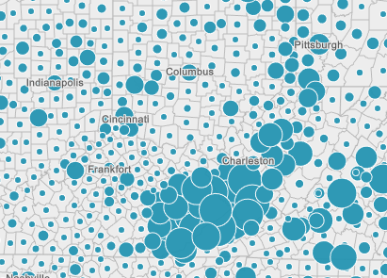
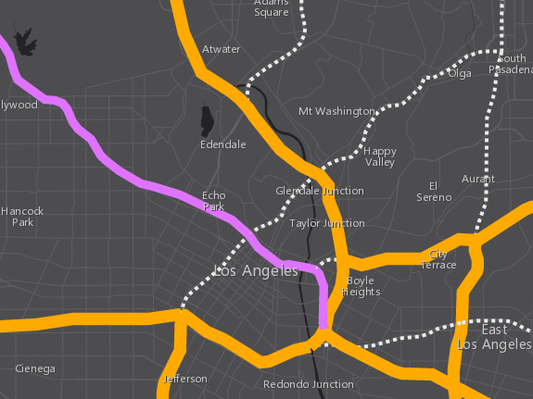
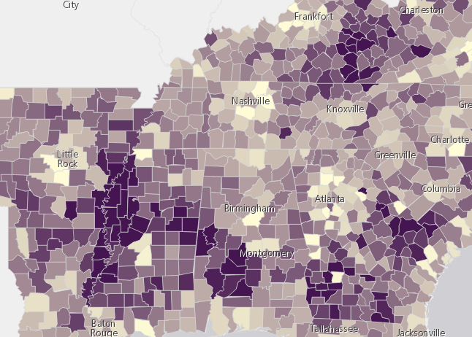


Symbols
based on geometry type
Points
Lines
Polygons
SimpleMarkerSymbol
SimpleLineSymbol
SimpleFillSymbol
PictureMarkerSymbol
PictureFillSymbol
WebStyleSymbol
CIMSymbol

Slide 7
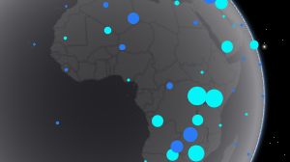
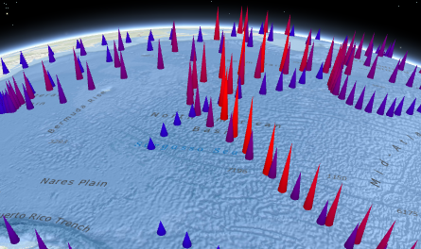
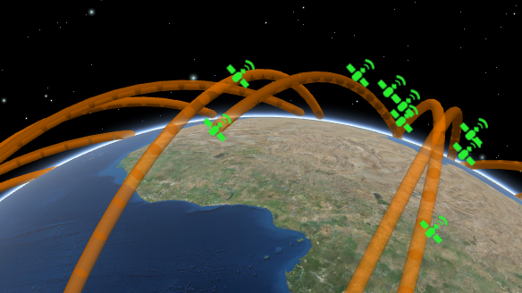
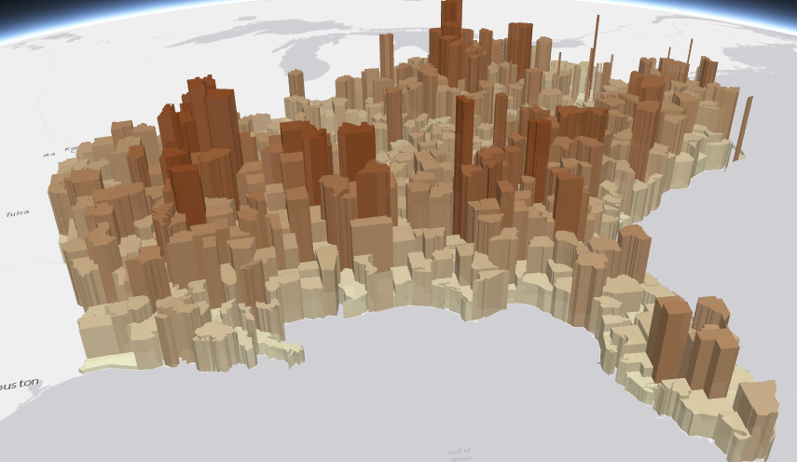
Symbols
PointSymbol3D
LineSymbol3D
PolygonSymbol3D
IconSymbol3DLayer
LineSymbol3DLayer
FillSymbol3DLayer
Flat
Screen size units (pt, px)
- Graphics are in screen space
PathSymbol3DLayer
ExtrudeSymbol3DLayer
Volumetric
- Real world units (feet, meter)
- Graphics are in real world space
ObjectSymbol3DLayer

Slide 8

Symbols
MeshSymbol3D
FillSymbol3DLayer

Slide 9
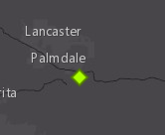
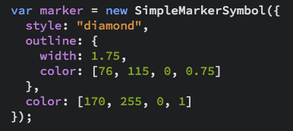
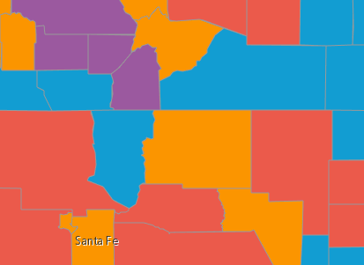
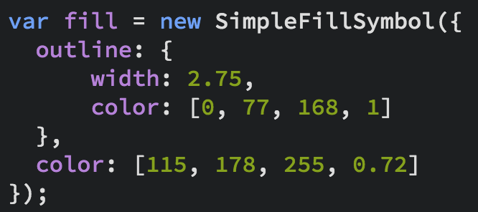
Symbols
Notes:
Show the playground here

Slide 10
Data
FeatureLayer
MapImageLayer
SceneLayer
StreamLayer
CSVLayer
GeoJSONLayer
FeatureCollection

Slide 11
Data-driven visualization
Field value(s)
TOTAL_POP
Arcade expression
Round( ( ($feature.BACHELOR + $feature.MASTER) / $feature.POP_25UP) * 100 );

Slide 12
Renderers

Slide 13
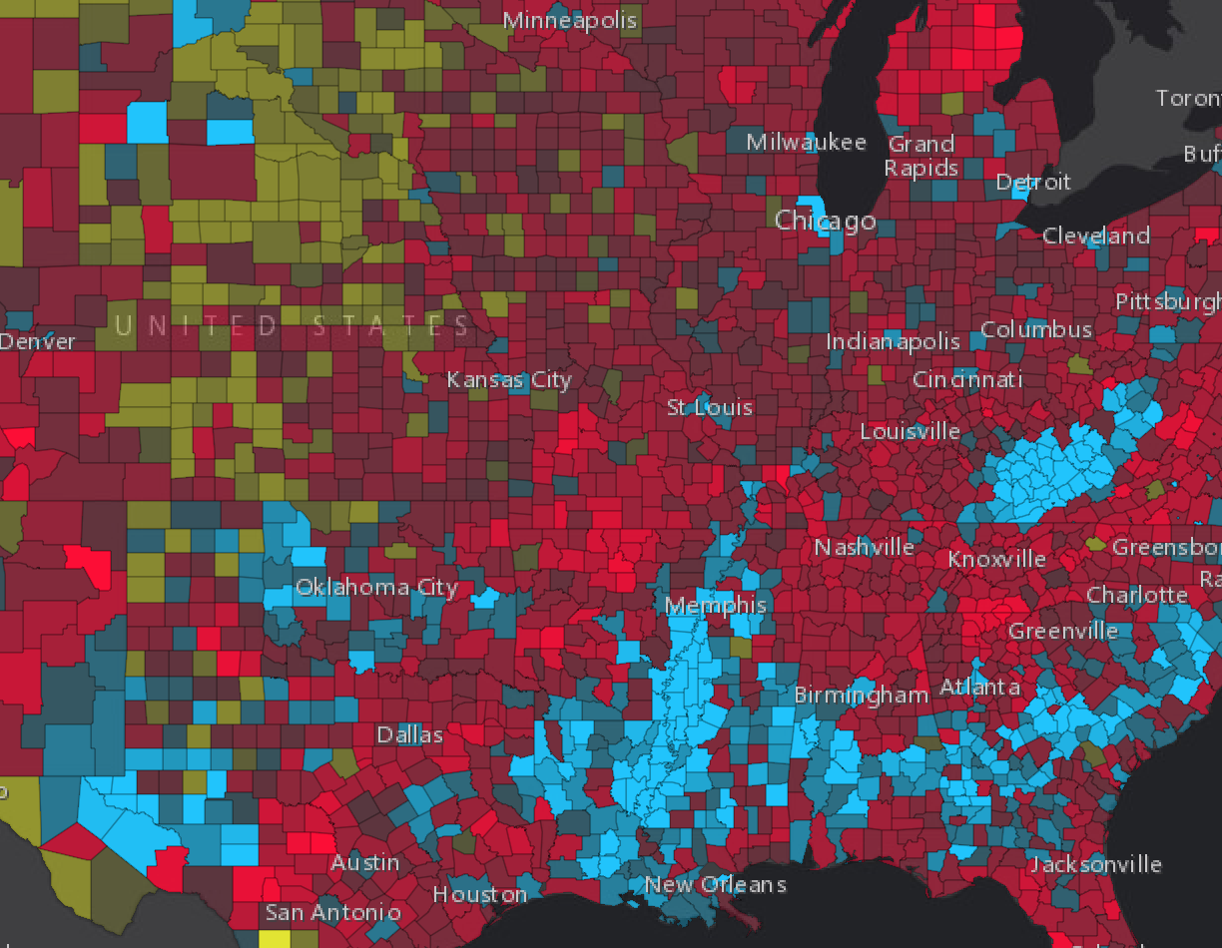
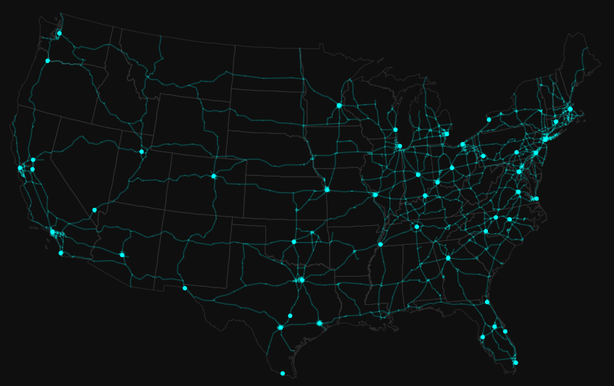
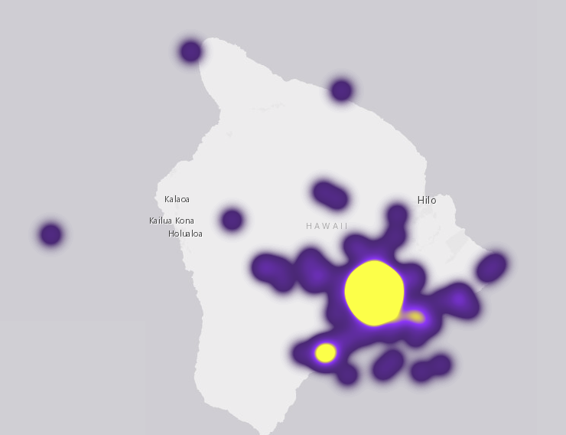
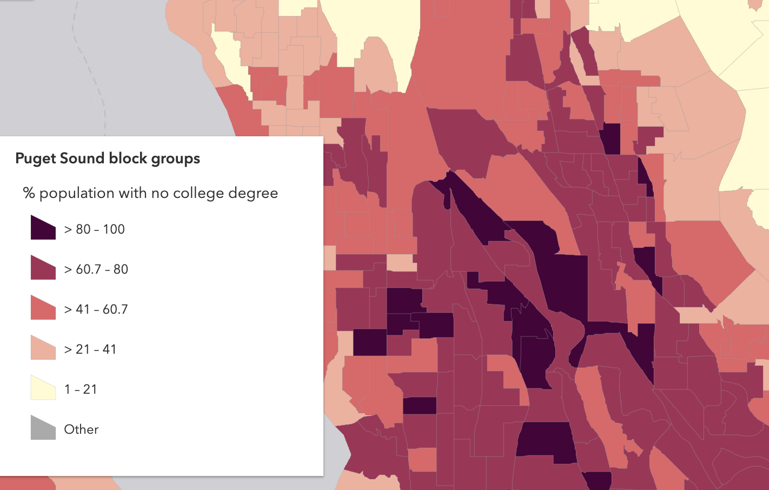
Renderers
UniqueValue
Simple
Heatmap
ClassBreaks

Slide 14
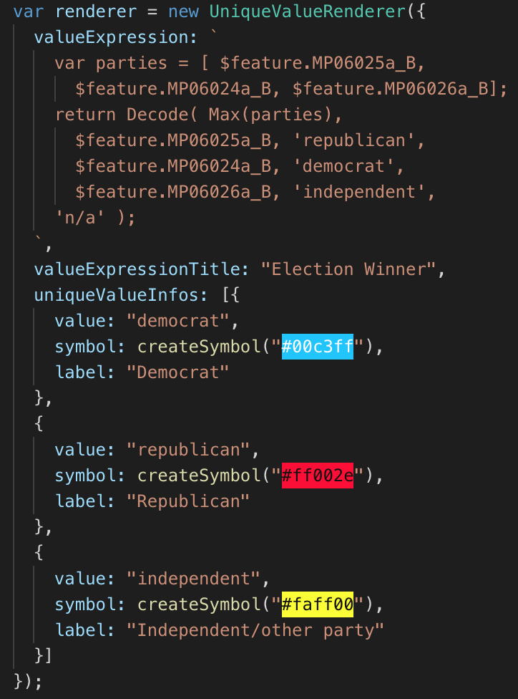
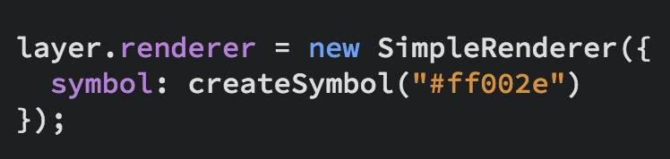
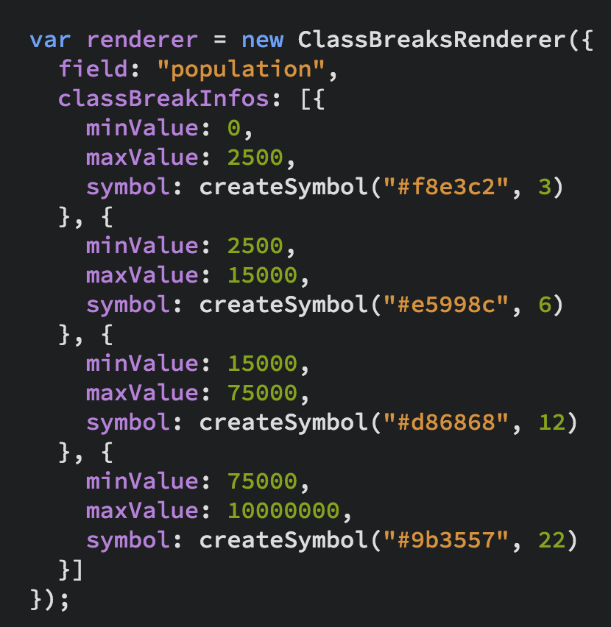
UniqueValueRenderer
Renderers
SimpleRenderer
ClassBreaksRenderer

Slide 15
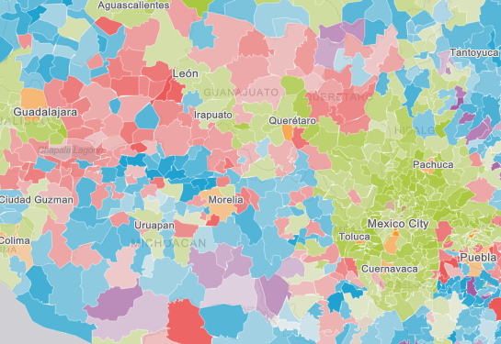
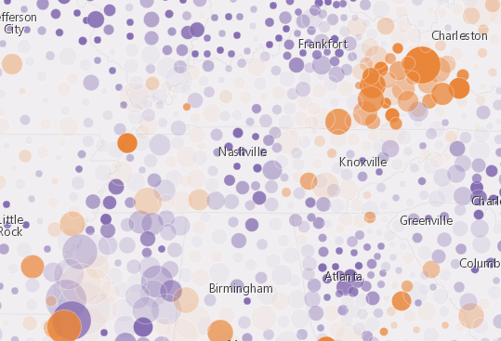
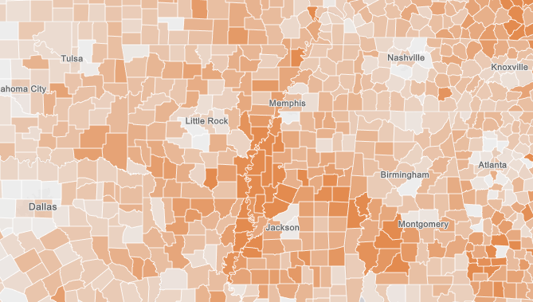
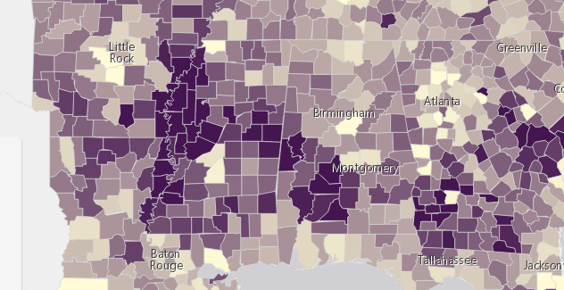
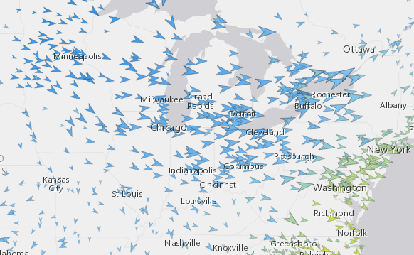
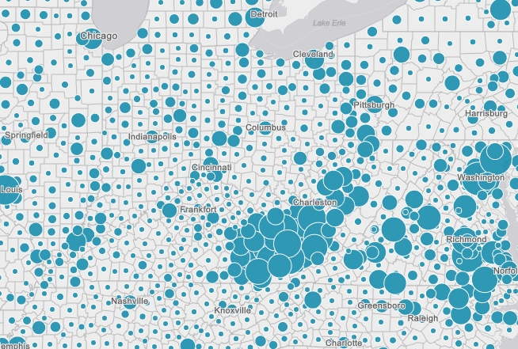
Renderers
Visual Variables
A property of the renderer
For numeric data-driven continuous visualizations
Color
Size
Opacity
Rotation

Slide 16
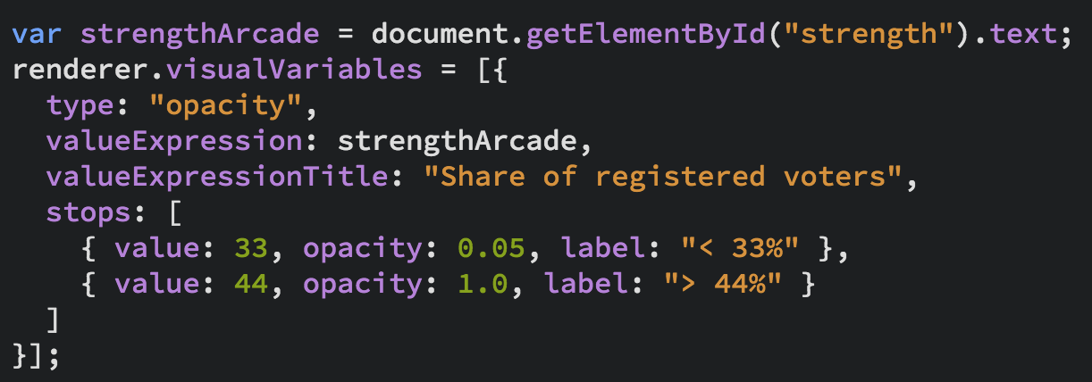
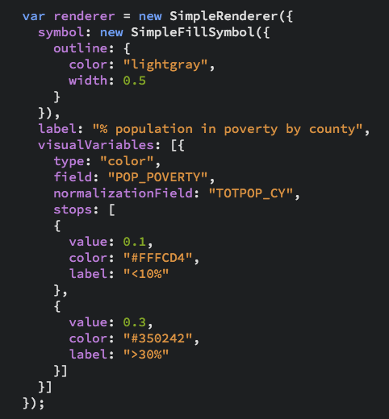
Renderers
Visual Variables

Slide 17

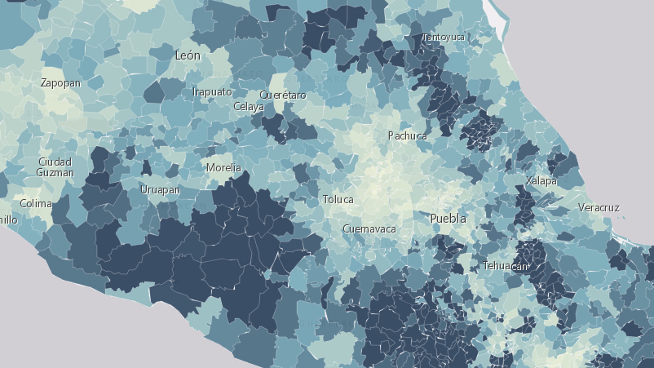
Examples
SimpleRenderer,Visual Variables, UniqueValueRenderer, Predominance, Arcade Expressions

Slide 18
Smart Mapping

Slide 20
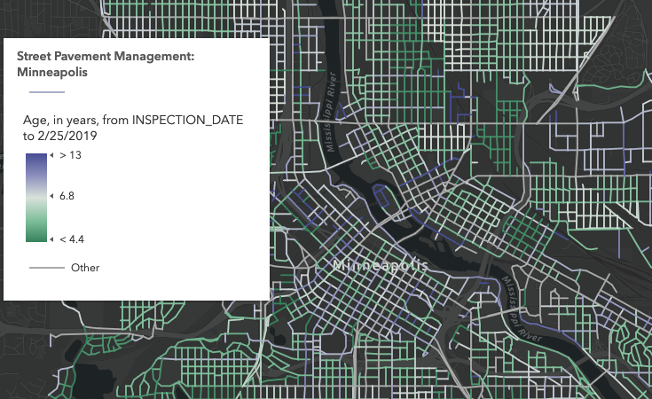
Age

Slide 21
Predominance

Slide 22
Relationship

Slide 23
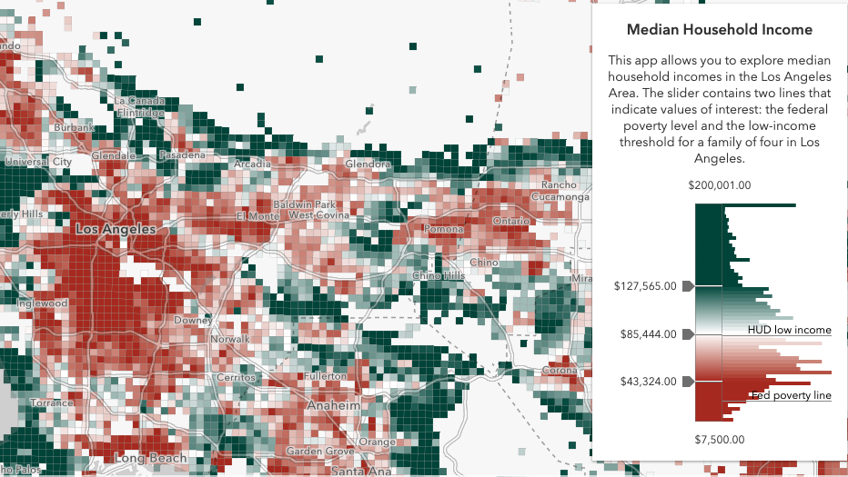
Data Exploration
Smart Mapping

Slide 24
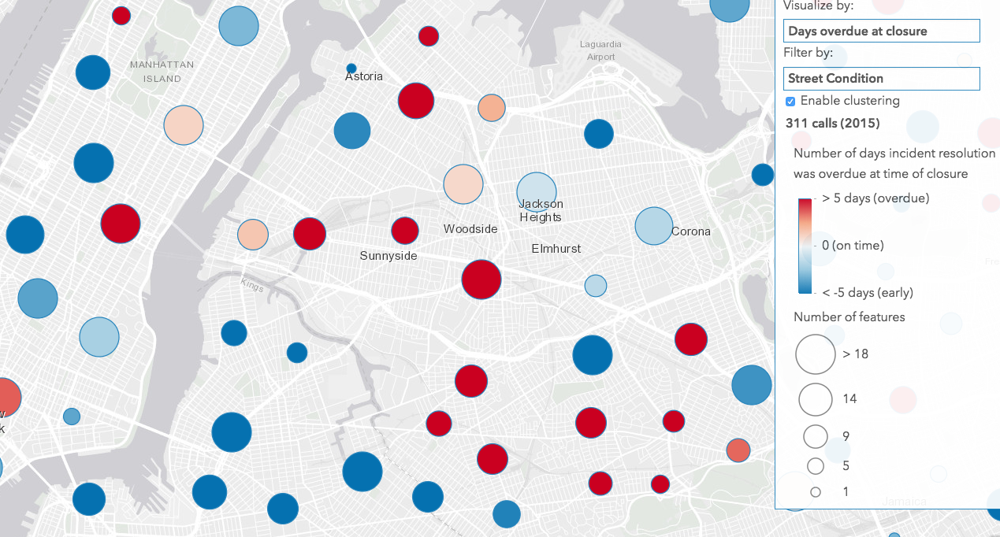
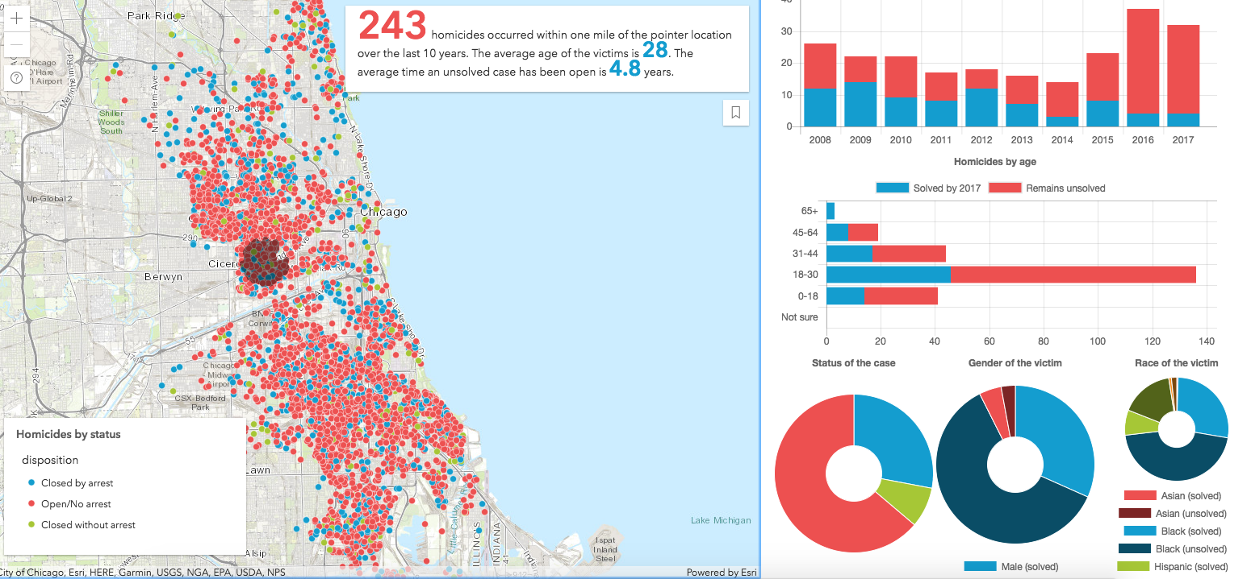
Visualize lots of data
Heatmap
Clustering
Display all of it!

Slide 25
Client-side processing
Client-side queries, Fast visual variable updates, Clustering, Heatmap

Slide 26
What’s new since UC?

Slide 27
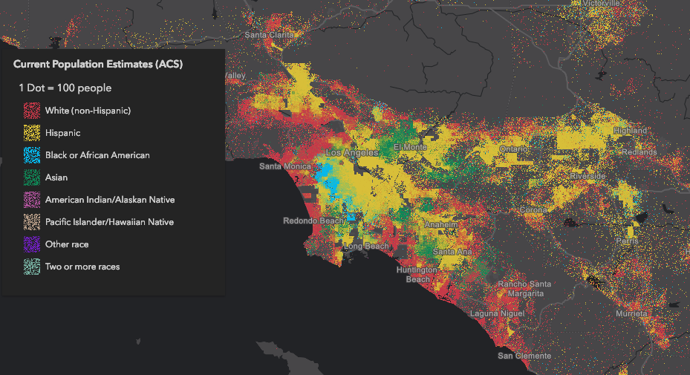
Dot Density

Slide 28
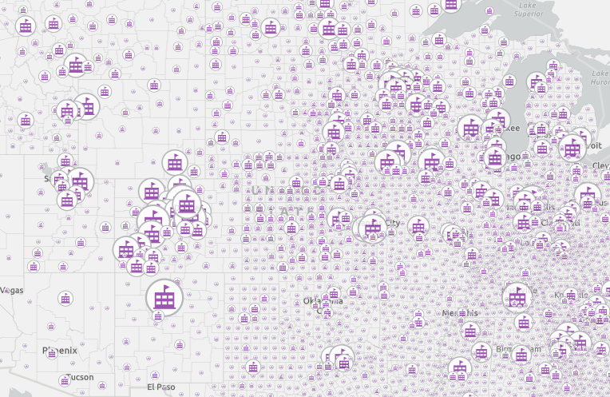
2D WebStyles
Scalable vector icons (CIM)

Slide 29
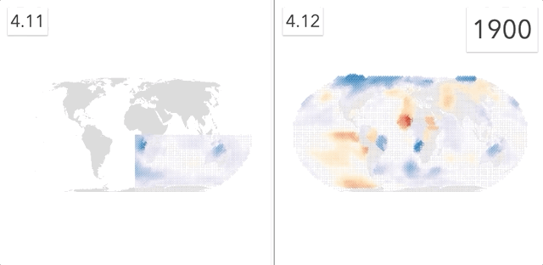
Faster visual updates
WebGL rendering across the board

Slide 30
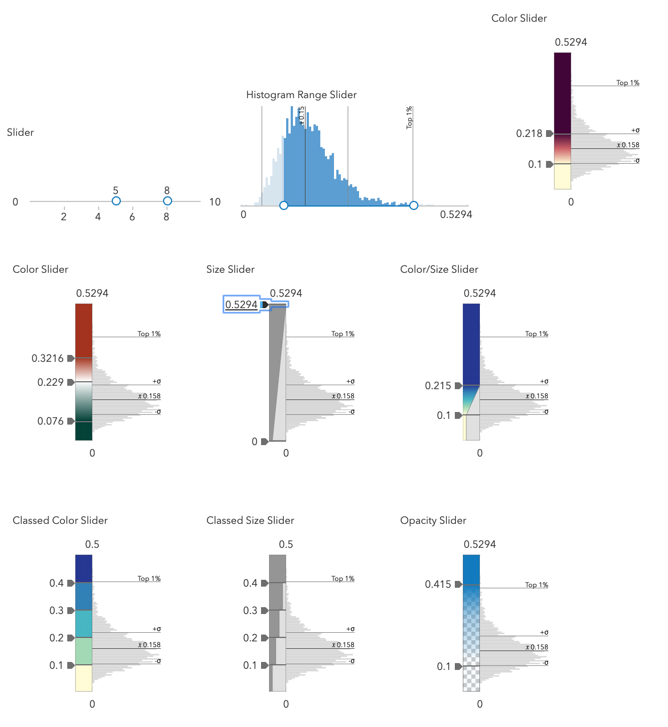
Smart Mapping Updates
Age
Predominance
Relationship
Dot Density
Scale
Outline width by scale
Size range by scale
Layer visibility by scale
New sliders!

Slide 31
FeatureLayer updates
More data can be displayed
MaxRecordCount factor by tile
pbf queries reduce payload size
Reduced feature duplication
Faster drawing (first draw and final draw)

Slide 32
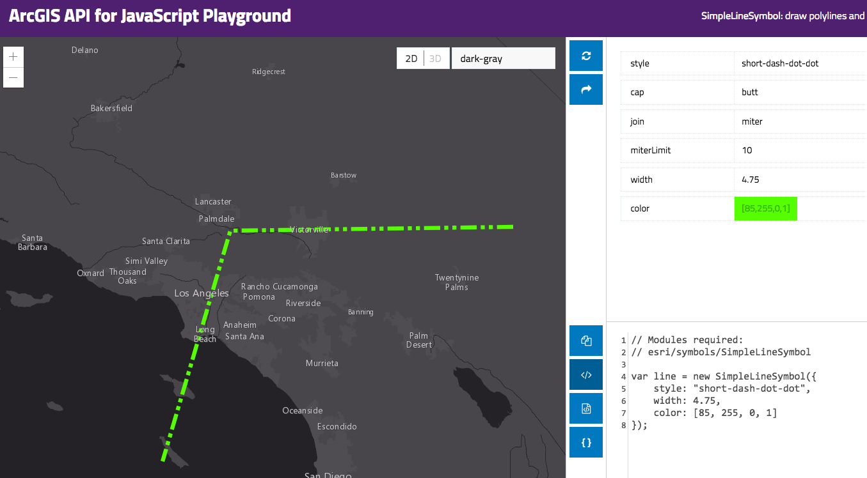
Resources
Get started with visualization
ArcGIS Blog
Visualization Samples
Documentation
Renderer
Symbol

Slide 33


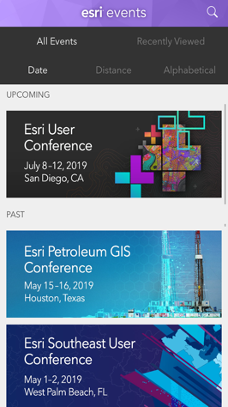
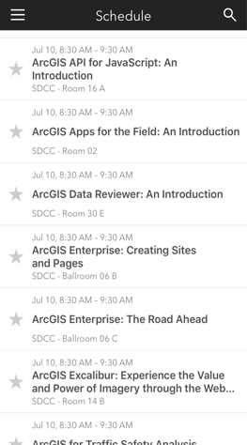

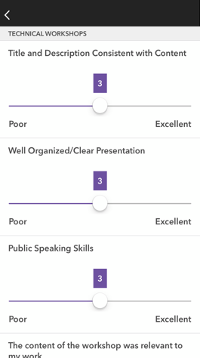




Please Share Your Feedback in the App
Download the Esri Events app and find your event
Select the session you attended
Scroll down to “Survey”
Log in to access the survey
Complete the survey and select “Submit”
Notes:
Guidance:
This is the survey slide. You can use the example as is or you can screenshot your session.

Slide 34


